Slide 1


Homebrew Kegerator Monitor
Michael Coquet, Ryan Betker,
Layne Forbes, Nnamdi Emezieke

Slide 2
Problem Description
Why it’s important we find the solution to this problem?
What are the constraint we must meet?
What’s the problem we are trying to solve?

Slide 3

What’s the problem we are trying to solve and why it’s important to find the solution?
Kegs in a kegerator go empty without any previous indication. Disturbing the kegs to check volume stirs up trub at the bottom of the keg and causes the next pour to be hazy. Brewing up a new batch can take weeks. To prevent a gap in-between these two, careful monitoring of the kegs (without disturbance) would allow for better timing on starting up a new brew without disturbing existing kegs.

Slide 4
What are the constraint we must meet?
The system will keep a log of the volume for up to 8 kegs at a time and store at least 2 years of data with a goal of 1 sample per hour.
The system will also monitor the temperature of the fridge which holds the kegs but doesn’t require logging with the volume..
The design must also be made to be as energy efficient as possible.
The most important objective is to accurately (+/- 500ml) measure the volume of a keg (up to 8 kegs at a time) and provide a wireless interface (up to 30ft) to be able to quickly and easily monitor the volume, temperature, and history of the kegs..
The design is meant to be external to the keg. Nothing can come into physical contact with the beer since this may introduce contaminants to the beer which will ruin the quality and pose health and safety risks.

Slide 5
The design must also fit within the fridge that stores the kegs with the following dimensions: 48” long, 21” wide, 30” high.
If something is to go under the keg, such as a scale, it must meet the clearance of at the most 3.5” above the kegs.
There is a maximum budget for the entire design process of $150 and a working prototype should be ready in March.

Slide 6

System Alternatives

Slide 7
System Alternatives
Persistent Storage
Interface
Power Source
Alternatives for the following components were generated:
Sensors
Microcontroller
Wireless
Notes:
- The parts of our system that have the most options are the sensors and microcontroller so we focused our alternatives analysis here

Slide 8
System Alternatives (sensors)
Line of Sight Alternatives:
Laser
Ultrasonic
Optics
Contact:
Liquid flow sensor (For the beer line)
Floats
Non-Contact Alternatives:
Strain Guage (Bathroom Scales)
Non-contact level sensor
Gas flow sensor (For CO2 line)
Radar, X-ray, Microwave
Possibly IR
Notes:
- Strain guage is the most common solution to the problem that we found.
Pros: cheap, widely available cons: each sensor needs a analog signal amplifier, and an ADC(depending on the micro might need extra)
- Non-contact sensor
Pros: also cheap and widely available cons: Would need some mechanical apparatus to move the sensor up/down the outside of the keg to find the level inside
Unknown if it would be powerful enough to go through the keg
- Gas flow sensor
Pros: doesn't need to be in the fridge cons: Very expensive
could be tricky to figure out volume, and very little information found on this concept
- Radar, X-ray, Microwave
Pros: very accurate cons: too expensive and potentially dangerous
- IR
Pros: one unit could potentially be used for all kegs cons: might not be enough difference in temperature to be able to see liquid level
Don’t need to attach anything to the kegs might not be able to see through the keg
Line of sight options
Pros: accurate, cheap, easy to use cons: have to modify keg to install window on the top, then need to worry about pressure and health/safety
The client specifically stated we are not to use anything that physically makes contact with the beer for health/sanitation reasons, but we thought we would still mention the contact options

Slide 9
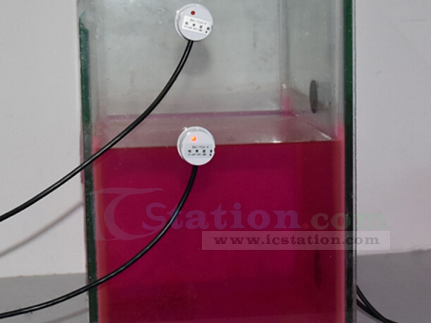
Non-contact level sensor
Detects boundary of liquid and gas from the outside of a container
Could potentially be moved mechanically up/down to find the level inside the kegs

Slide 10
System Alternatives (Microcontroller)
TM4C123 Launchpad (from 332)
Raspberry Pi zero
Teensy
Others we considered:
Arduino (uno, nano, etc.)
ESP32
BeagleBone

Slide 11
System Alternatives (Wireless, Storage)
Storage Alternatives:
SD card/s
USB drive
Web/cloud
Others:
External HDD
Wireless Alternatives:
Bluetooth
WIFI/web
RF
Others:
Zigbee
GSM

Slide 12
System Design
. . .
Temperature
Sensor
Keg_0
Keg_1
Keg_7
Scale_0
Scale_1
Scale_7
User
Amplifier_0
Amplifier_1
Amplifier_7
Interface
Power
Supply
Unit
Microcontroller
Storage
RF transmitter/reciever
RF transmitter/reciever

